Slide 1
Information – A Strategic Asset
“To manage a business well is to manage its future; and to manage the future is to manage information.”
Marion Harper
Notes:
Introduce yourself
My presentation today the changing face of managing information at a major incident, such as Yarloop/Waroona - especially in an electronic world, and the changes in the way information is collected and managed before, during and after an incident.
The increase in significant and major incidents over the past 3 -4 years has been just one of the drivers –Parkerville, Margaret River and more recently Esperance and Waroona and the subsequent inquiries.
Public expectorations have changed with increased requests for information, again before during and after an incident.
FOI – 184 an increase of 57 on previous financial year
So who are DFES

Slide 2
DFES
The Fire and Emergency Services (FES) Commissioner is the Hazard Management Agency in Western Australia for:
fire,
hazardous materials incidents,
flood,
cyclone,
storm,
earthquake,
Tsunami, and
collapse – landform or structures.
Government of Western Australia Department of Fire and Emergency Services
Notes:
The Fire and Emergency Services (FES) Commissioner is the Hazard Management Agency in Western Australia for fire, hazardous materials incidents, flood, cyclone, storm, earthquake, tsunami and collapse – landform or structures.
Within DFES these are known by the generic term ‘Incident’. As you can imagine a significant amount of information is gathered during any one of these incidents. During a major or significant incident the amount of documentation gathered can be vast. This information will then play a critical part in the review and evaluation of that incident.
Not to mention the more mundane uses such as insurance claims and FOI requests.

Slide 3
From FESA to DFES
FESA – 2000 only 100 TRIM licences
DFES – 2016 over 1000 licences
Invested in:
Online Records Awareness Training
Outsourced RM8 training
Government of Western Australia Department of Fire and Emergency Services
Notes:
In 2000 Fire and Emergency Services Authority (FESA) invested in 100 TRIM licences. These were used primarily by records officers and administrative staff to register documents in TRIM.
2014/15 after incidents such as Parkerville and Margaret River and the subsequent report (Kelty) the DFES investment in managing information started to show results.
The 2015 -2016 fires season brought together the information strategies and business improvements that were being worked on in the off season.
So now, Department of Fire and Emergency Services (DFES) has 1020 TRIM licences,
has upgraded to HPE Records Manager 8.3 (HPERM),
has invested in online records awareness training and
is on the cusp of integrating HPERM with a number of business systems as well as SharePoint.

Slide 4
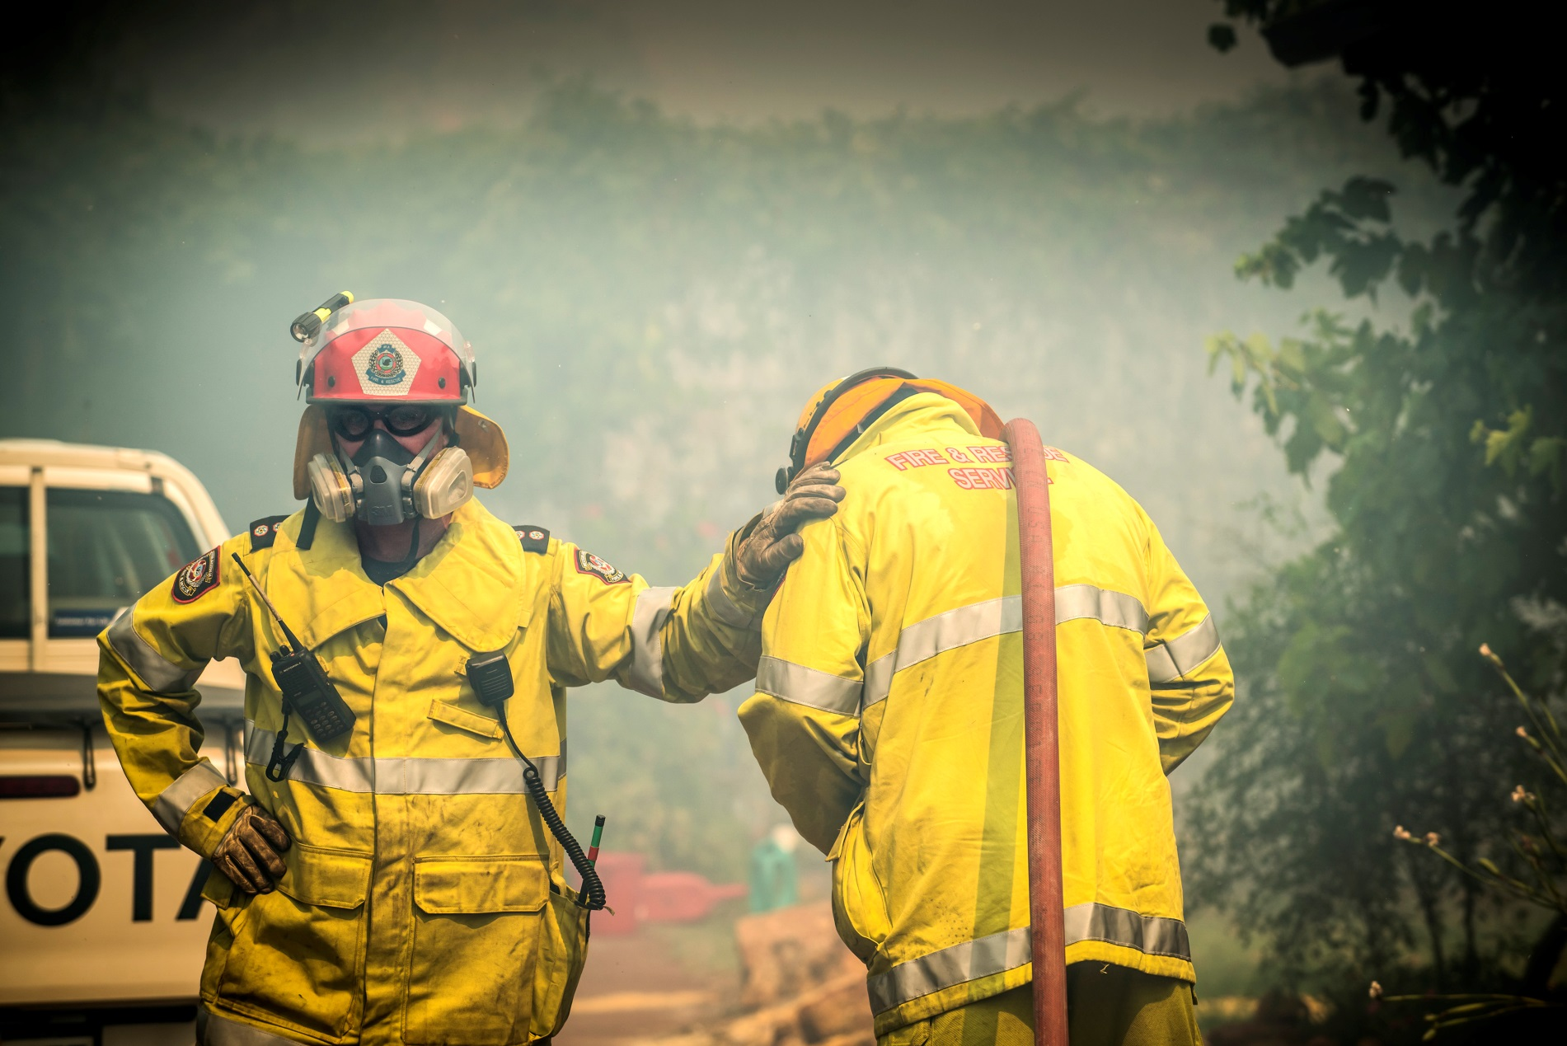
2015 - 2016 Fire season
Government of Western Australia Department of Fire and Emergency Services
Notes:
This photo was taken at the Parkerville fire.
The impact and the growing number of these major incidents has been to speed up the journey, significantly.
So let me set the scene. What information is being gathered and shared?
The ‘All Hazards Information Management System (AHIMS) Officer’ was telling me about the time she turned up at a car park with her incident bag, opened up the card table and chair, set up her laptop and used her phone to link to the network and started work. That was it, there was nothing else.
Can you imagine a 40 degree day – in hazard gear – a standing in ambient heat radiating from the fire.
Or you’re the admin officer on team 1 trying to gather the information – its on paper, could be covered in dust, wet and then again on a laptop, an email, and you are responsible for taking the minutes.
Then there are the Officers have incident diaries that record what is happening through out the day.

Slide 5
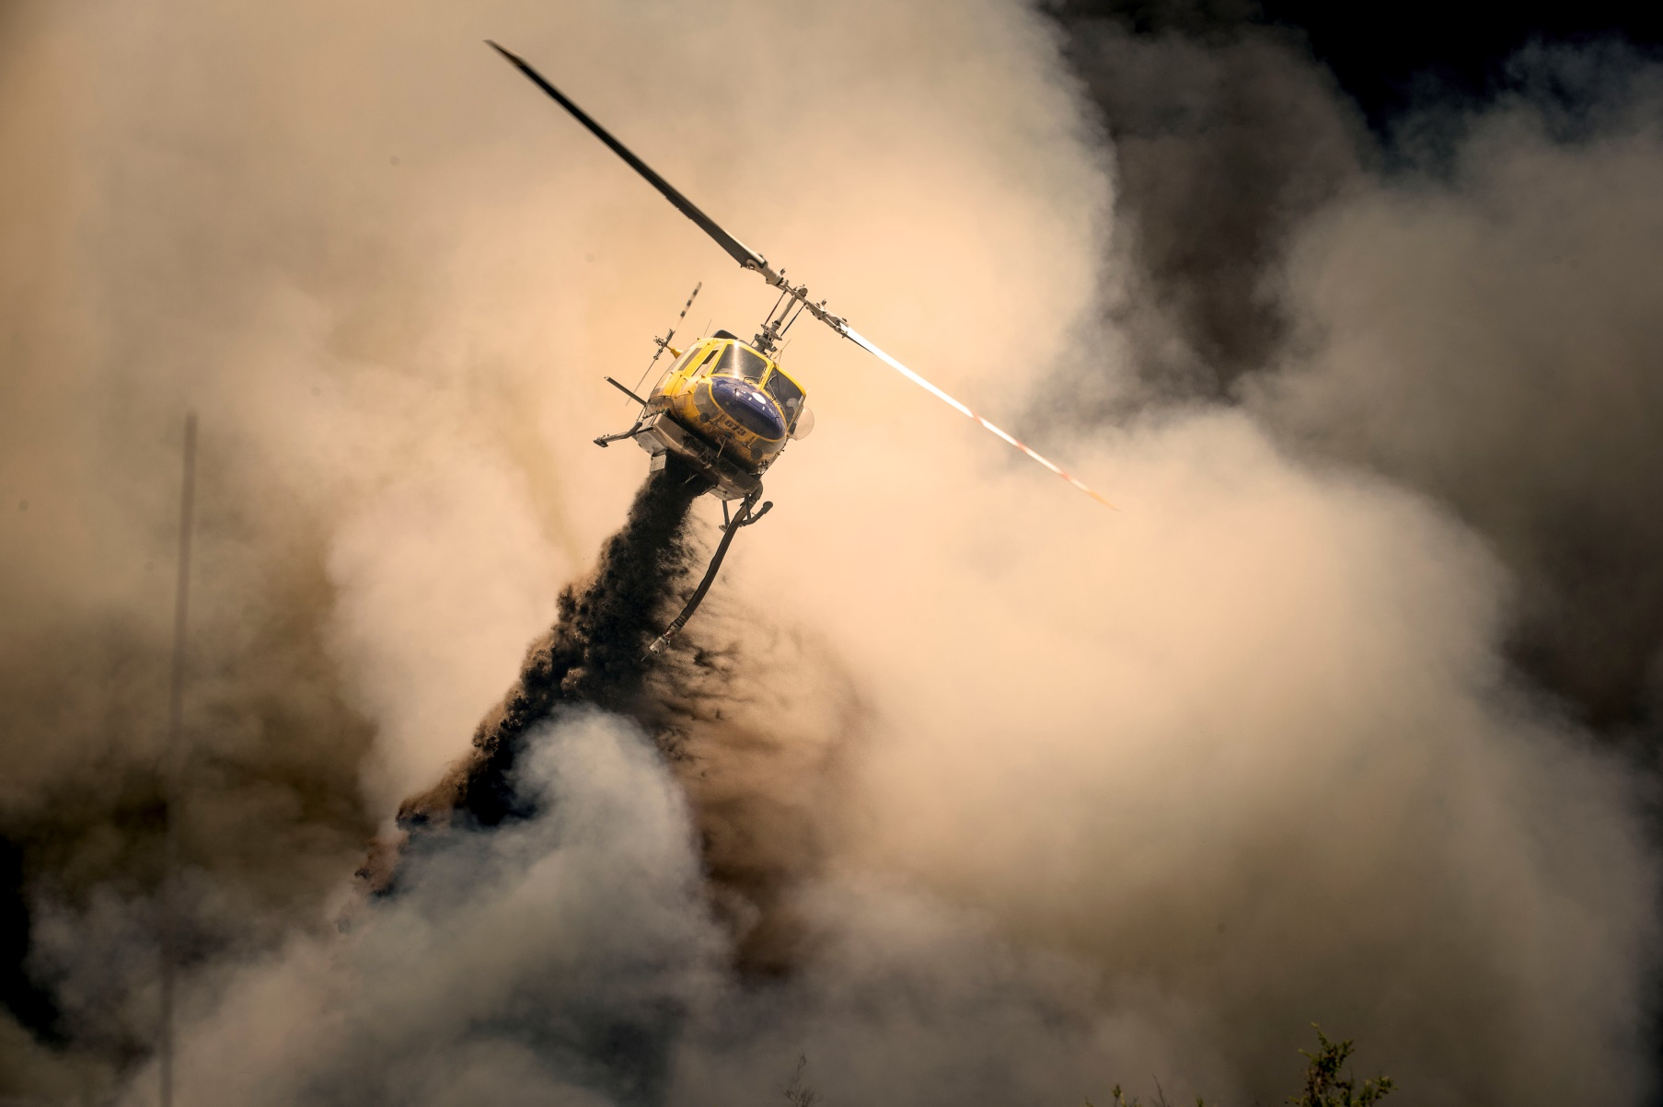
Government of Western Australia Department of Fire and Emergency Services
Notes:
There are 3 levels of incidents - at a Level 3 DFES becomes the managing agency.
So now there are officers from the Police, Parks and Wildlife, St John Ambulance to name a few.
So how can we manage the incident without putting a unworkable layer of red tape around what needs to be done, but still capture information, but not hinder those trying to do their job – vicious circle….
There is a public expectation that there is an audit trail – after all putting out fires does not come cheap.
As you can imagine the information comes in all shapes and sizes but what happens to it, how is it captured and used before during and after an incident.

Slide 6
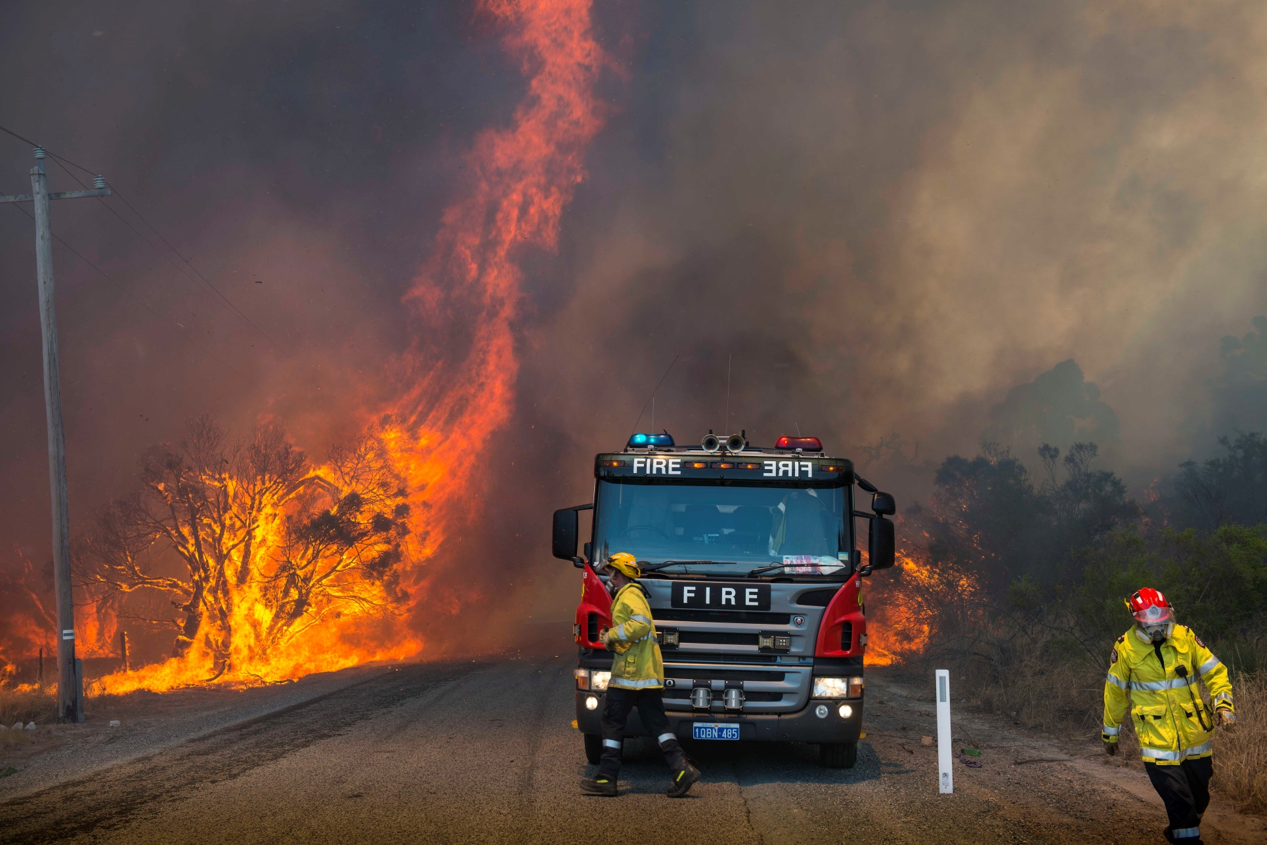
Government of Western Australia Department of Fire and Emergency Services
Notes:
Volunteers and career firefighters need to be feed and watered – otherwise it can end up on the news…
PO and Invoices – ensuring that work is NOT undertaken without approval.
Maps – making sure they are current and get the right people.
Who is on the fire ground – what equipment is on the fire ground
And what is in the air – Elvis and helitacs. These provide information to the GIS team to make sure the fire maps are correct.

Slide 7
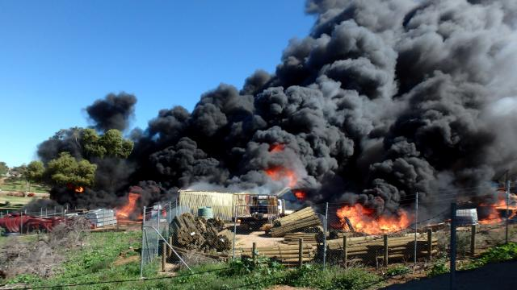
Government of Western Australia Department of Fire and Emergency Services
Notes:
Dare I mention social media such as media releases. These formed a major role in the Ferguson inquiry – when was Yarloop mentioned in the media releases to evacuate?
The press call from around the world – I was helping Media during the Margaret River fires and I was fielding calls from Canada and the UK.

Slide 8
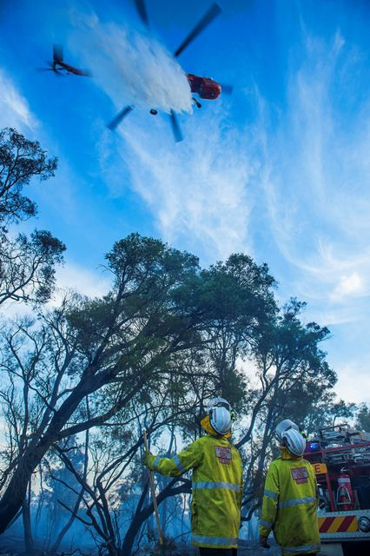
Government of Western Australia Department of Fire and Emergency Services

Slide 9
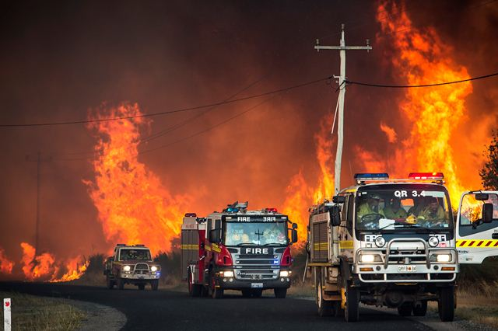
Government of Western Australia Department of Fire and Emergency Services

Slide 10
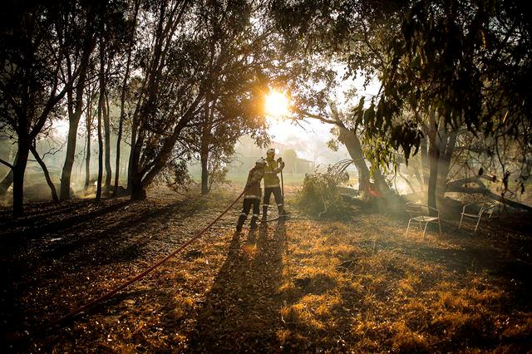
Government of Western Australia Department of Fire and Emergency Services

Slide 11
Type of information captured
Incident diaries
Media releases
Minutes
Hazard Reports
Maps
Video
Recordings including CCTV, phone, etc
Government of Western Australia Department of Fire and Emergency Services
Notes:
Go through type of documentation and format.
I’ve mentioned briefly the type of information gathered - it is a significant amount of significant information.
This information is gathered not only from the ComCen in Cockburn but also from the ROC and MOC and the ICV’s that were involved.
This information will then play a critical part in the review and evaluation of that incident.
The Ferguson inquiry took over 5 staff two weeks to collate - without TRIM and the processes put in place over the past couple of years that would have been a much larger task.

Slide 12
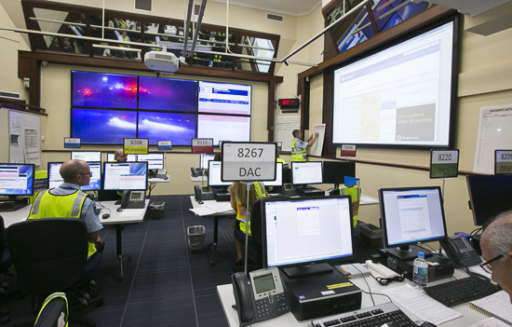
Managing Information
Government of Western Australia Department of Fire and Emergency Services
Notes:
This photo is taken at the SimCen in Belmont.
During the summer of 2015-2016 WA unfortunately experienced two major incidents; the Esperance fires and Waroona/Yarloop fires.
And unfortunately there were fatalities at both.
So with the experience of these two incidents the project team undertook a ‘lessons learnt’ review, what could be done to build on and improve processes from these experiences.

Slide 13
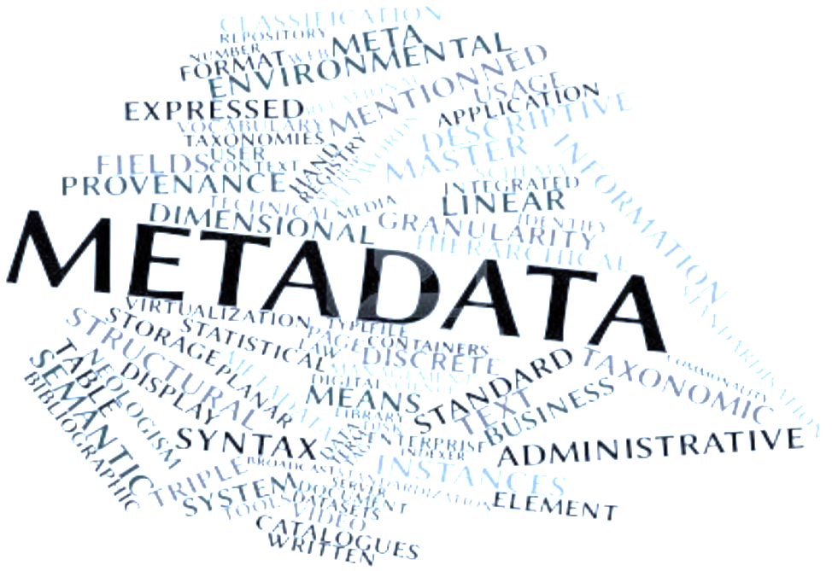
Metadata to the rescue
Manage information rather than a document
Use metadata to ‘wrap’ information
Metadata – capture once use many times
Government of Western Australia Department of Fire and Emergency Services
Notes:
One of the biggest challenges is capturing and representing the information back in a meaningful way.
Metadata to the rescue – using metadata to wrap this information we are able to use RM8 to create a ‘dashboard’ with data that is meaningful to the end user from operations to media.
Again working with staff in the State Operations Centre a Standard Administrative Procedure (SAP) has been developed. This outlines file and document naming conventions, what information should be captured, who should capture that information and where that information should be captured. And importantly states that HPERM is the ‘Source of Truth’ as the repository for all DFES incident documents.

Slide 14
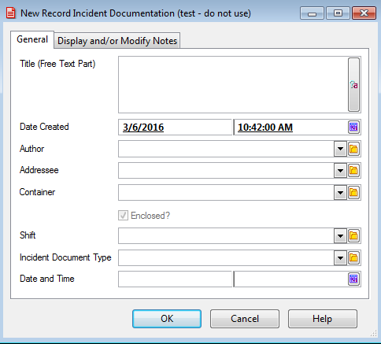
What metadata can do for you - Incidents
Government of Western Australia Department of Fire and Emergency Services
Notes:
What were the changes:
Title – agreed terminology
Drop down list used to collate information
Prevent spelling and terminology mistakes – I call it shift you call it team
No more than 10 terms per drop down
Date and time in this instance relates to the time the information was recorded/created at the incident

Slide 15
What you can see
Sort by day and time
Sort by document type
Government of Western Australia Department of Fire and Emergency Services
Notes:
Magic – you can manipulate the metadata to tell the story.
Just need to see weather reports – doable
Date and time – doable
For information such as media releases the time and date that they were published is critical in a post incident review or investigation.
We are looking at adding SOC Team and Incident number as a separate field
We have presented the changes to the SOC teams and asked them to think about why you are saving this data, how would you like it re-presented to you.
Its still a work in progress and will be included in the next mock incident.
Using saved searches you can bring back the information in the format that you need.

Slide 16
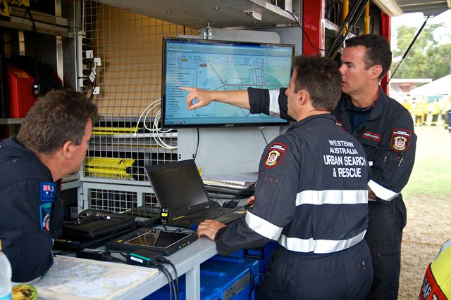
In the field
Government of Western Australia Department of Fire and Emergency Services

Slide 17
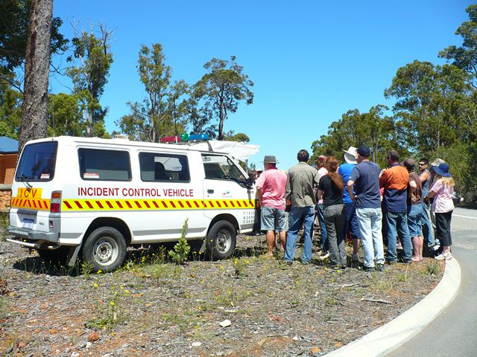
In the field
Government of Western Australia Department of Fire and Emergency Services
Notes:
One innovative idea from the ‘lessons learnt’ review was the need for high speed scanners with the capacity to scan and register directly into HPERM. As a result a number of scanners have been purchased for the State Operational Centre, the Metropolitan Operational Centre, Regional Operational Centres and the Incident Control Vehicles (ICV). There they can be used to capture the paper records directly into HPERM.
But it is not as simple ‘oh lets scan’ -
The use of the scanners in the Incident Control Vehicles will open up new challenges. The vehicles are located in the field, literally, and access to technology can be limited or non-existent.
It was important that the documents could be scanned in colour, quickly, duplexed and then either queued for inclusion in RM or scanned directly into the system.
Can they be scanned on the fire ground and then indexed by someone in one or the command centres?
Can we utilize volunteers?
Can the software be smart enough to pre index and save time and mistakes?
And will they fit in the van?
With support from IP we were able to say yes to all of this.

Slide 18
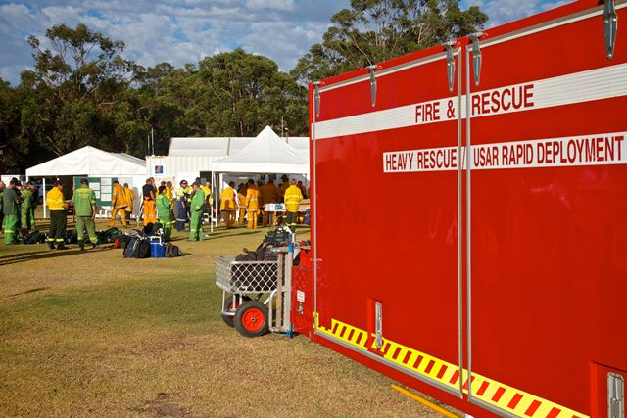
Scanning – what is it good for…
Government of Western Australia Department of Fire and Emergency Services

Slide 19
Endless possibilities
Thinking outside the box
Sharing information
Who else can use this information
Government of Western Australia Department of Fire and Emergency Services
Notes:
So what is different.
The questions to our customers, our stakeholders is different.
What can we do for you so you will save your information into RM? How can we assist with the cultural shift.
Apologies to the RM purists - we are moving away from KWAA – we map file titles to the R and D and everyone is happy.
To be honest staff want some form of structure but it needs to be relevant to their business needs.
As we did with Incident documentation – lets make the changes to the way information is captured so it can be reused.
Ask - What do you want to be able to do with your information – who can you share this information with? Value add.
Working with providers such as Information Proficiency we are looking at solutions to those challenges.
Training, support, innovation, problem solving
There has been a perfect storm at DFES and the change to the way we capture and use information has been significant.

